Slide 1
The evolving Internet industry Disaggregation, SDN and NFV
CS144 An Introduction to Computer Networks

Slide 2
Coming up later this week….
Wednesday: Jeff Mogul (Google)
He will build on some of the things you will learn today.
Friday: (Nick) Network Virtualization.

Slide 3
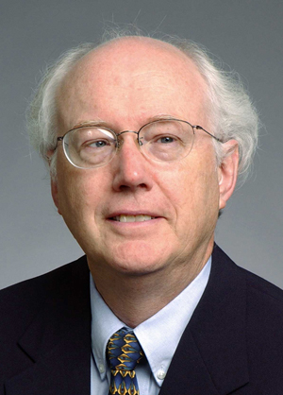
David D. Clark
Chief Protocol Architect, Internet
1981 - 1989

Slide 4
Architectural Principles
1
Dumb and simple
i
Streamlined, fast, low-cost, easy to maintain, infrequent upgrades.
Reliable in-order delivery can be built on top, at the end-points.
i
Intelligent end-points (computers).
2
Notes:
ADD: LAYERS OF ABSTRACTION????

Slide 5
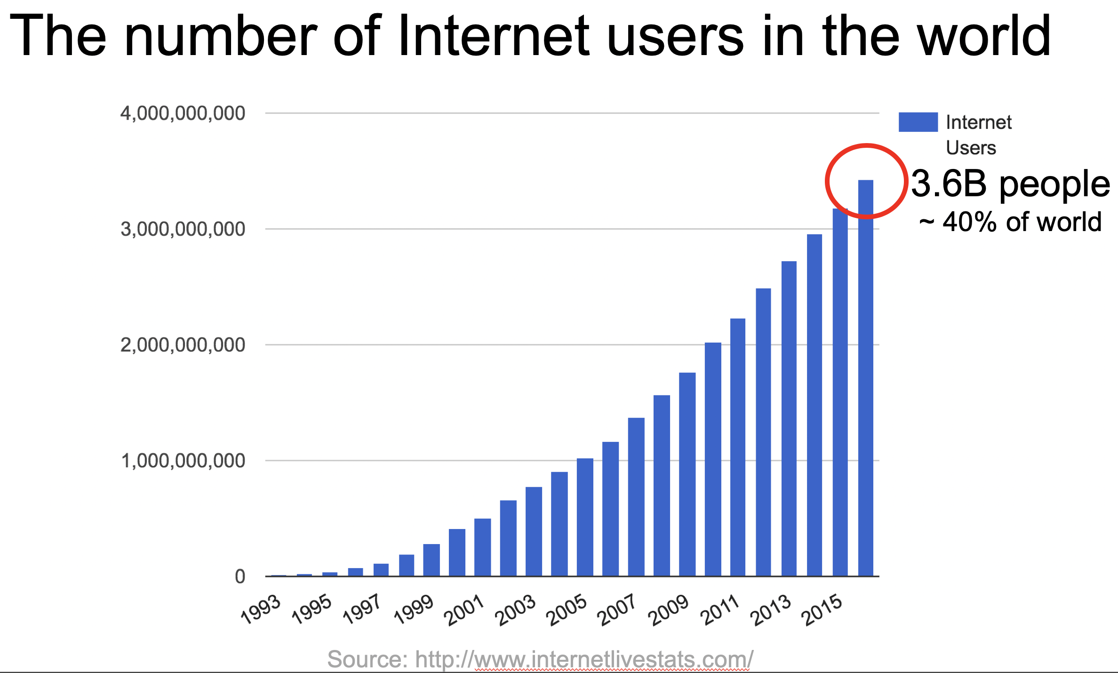
Architectural Principles
3
Decentralized control
i
Rapid organic growth
Notes:
: Four nodes
UCLA, SRI, UCSB, Utah.

Slide 6
Tension
The Internet was carefully designed …
To be simple and streamlined.
To have decentralized control: Lots of individually controlled pieces.
Which led to …
Explosive organic growth of the Internet.
A great business for companies selling routers.
simple and streamlined
A great business
Notes:
About $100B per year. 70% gross profit margin. Which means for every $100 of goods sold, they cost $30 to build. Not bad.
So there is a business paradox here. Or rather, the situation is not stable: Simple and Streamlined is at odds with “A great business” <click>
There are two ways to break the instability: Either the Internet becomes a simple and streamlined commodity and is not particularly profitable. This would have been the social good.
Or, we break the simple and streamlined to justify keeping the profit margins high, and keeping others out of the business. Which would you do if you had a very successful, great business?

Slide 7
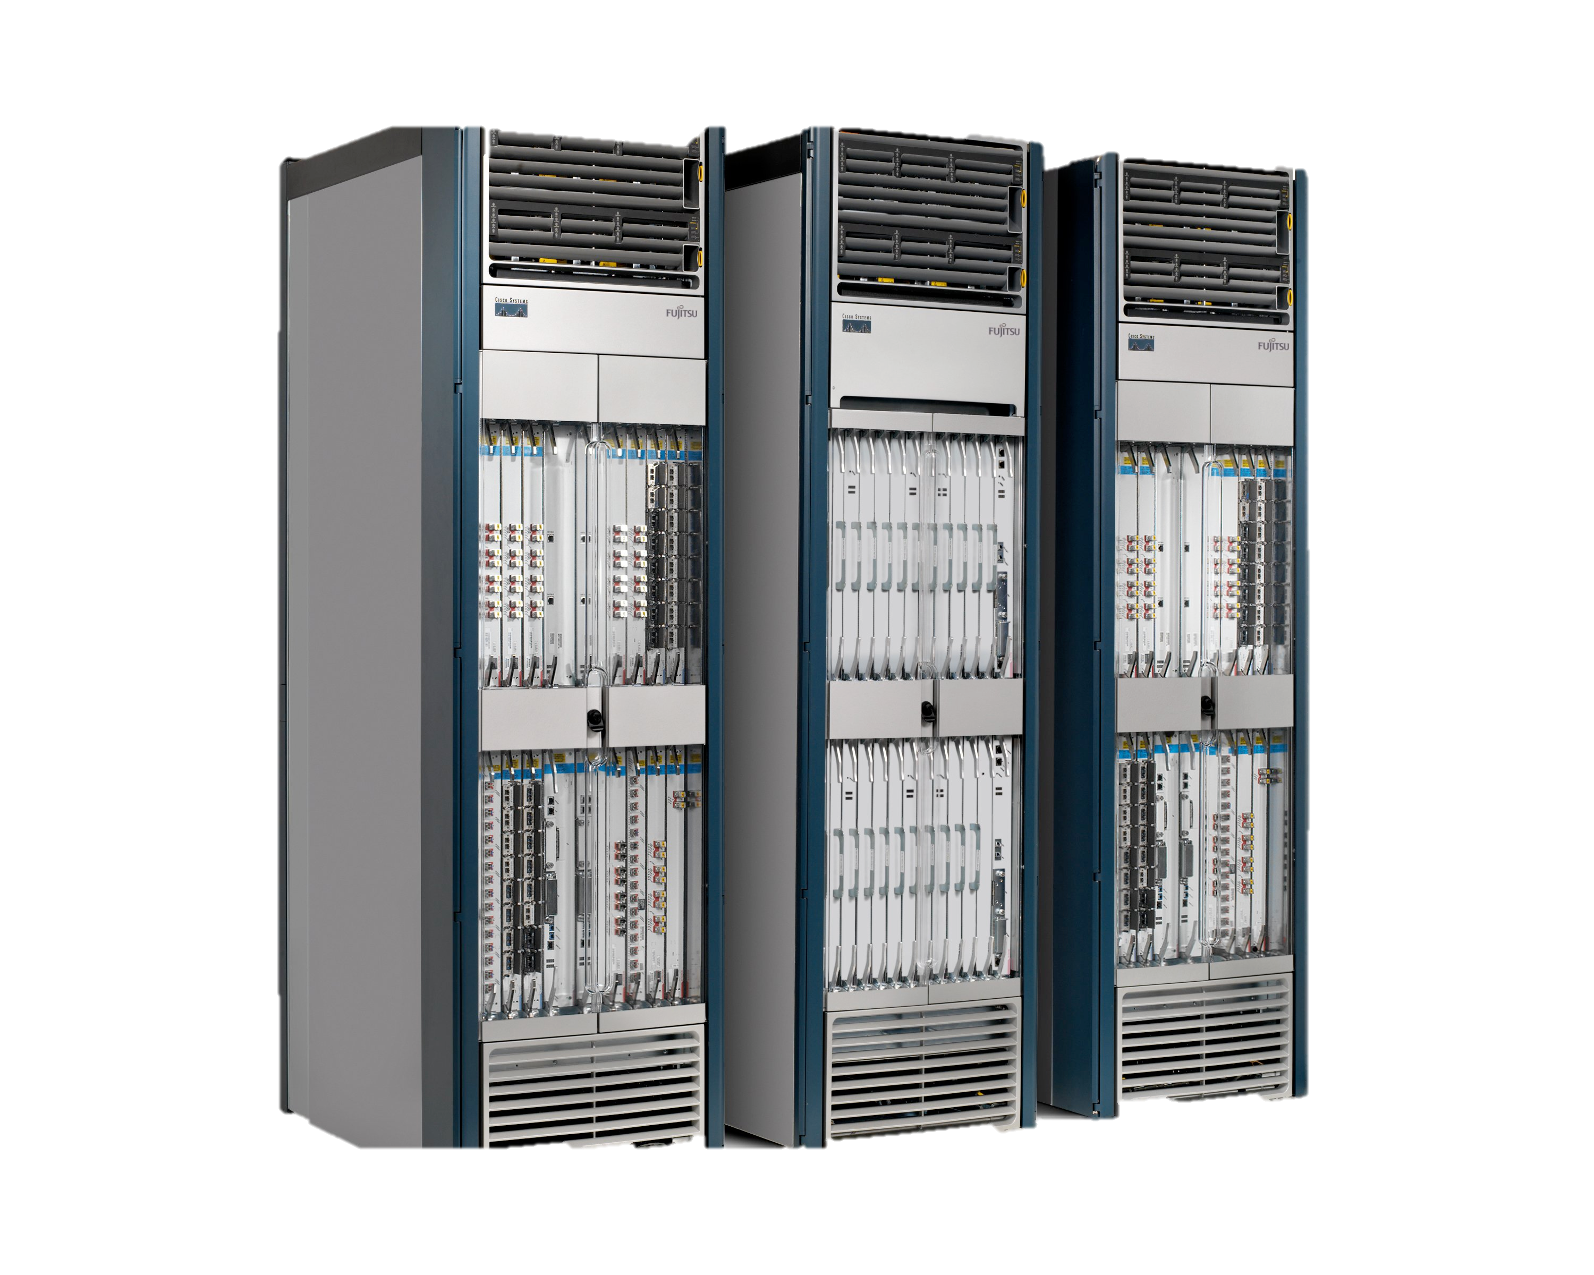
What public Internet routers do
Large Public Internet Router

Slide 8
Software
Software
Hardware
Software
Hardware
Software
Hardware
Hardware

Slide 9
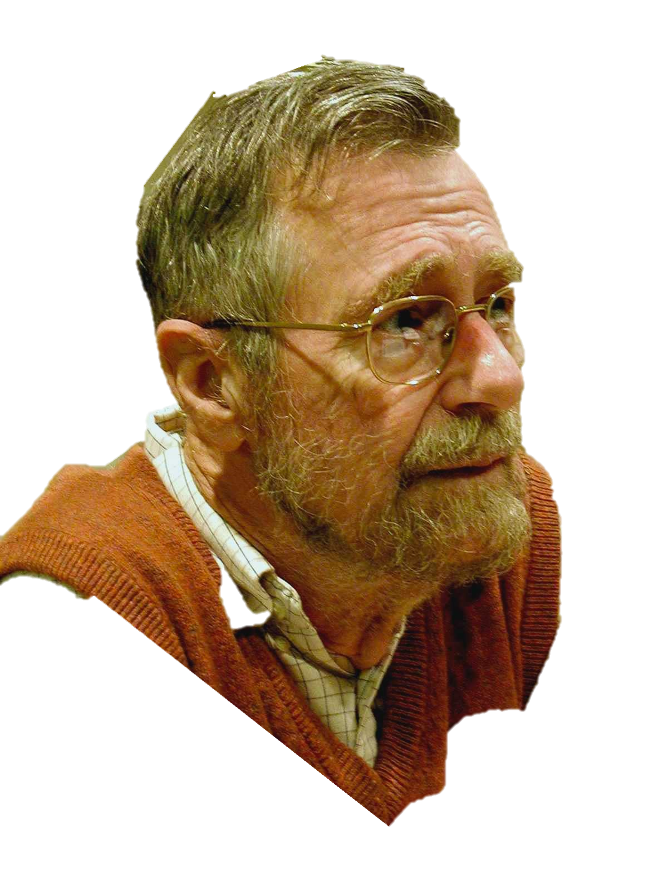
function Dijkstra(Graph, source):
for each vertex v in Graph:
dist[v] := infinity ;
previous[v] := undefined;
dist[source] := 0 ;
Q := the set of all nodes in Graph ;
while Q is not empty: // The main loop
u := vertex in Q with smallest distance in dist[] ;
remove u from Q ;
if dist[u] = infinity:
break ;
for each neighbor v of u:
alt := dist[u] + dist_between(u, v) ;
if alt < dist[v]:
dist[v] := alt ;
previous[v] := u ;
decrease-key v in Q;
return dist[], previous[];
end function
Edsger Dikjstra
1930-2002
Photo: Hamilton Richards
Notes:
Edsger Dikjstra – 1956 (publushed 1959)
Takes

Slide 10
Figure out which routers and links are present.
Run Dijkstra’s algorithm to find shortest paths.
B
“If a packet is going to B, then send it to output 3”
Software
Software
Hardware
Data
B
2
Software
1
Hardware
B
“If , send to 3”
Hardware
B
Software
3
Hardware

Slide 11
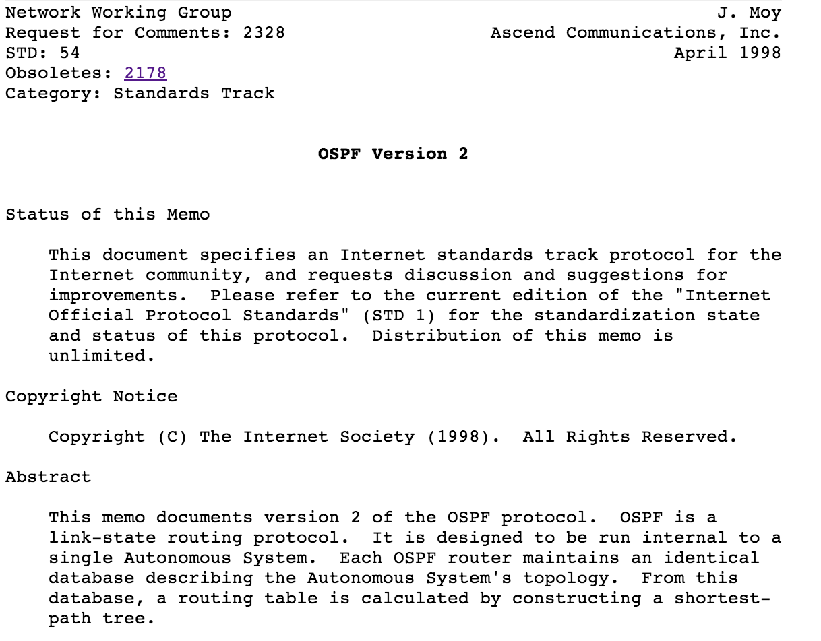
95%
Figure out which routers and links are present.
Run Dijkstra’s algorithm to find shortest paths.
5%
Software
Software
Hardware
2
Software
1
Hardware
B
“If , send to 3”
Hardware
B
Software
3
Hardware

Slide 12
95%
Figure out which routers and links are present.
Run Dijkstra’s algorithm to find shortest paths.
5%
50,000 lines of code
50,000 lines of code
Software
Software
50,000 lines of code
Hardware
Software
Hardware
Software
Hardware
Hardware
Building a reliable distributed system is really hard!

Slide 13
Number of published Internet RFCs
Notes:
First one published April 7, 1969
Most of these are written and publised by the router companies themselves.
As a result, the

Slide 14
By 2005
Internet routers were complex: Over 100M lines of source code
They were closed and proprietary, vertically integrated, expensive.
Very hard to manage or control as a network. No clean APIs.
ISPs felt under a “stranglehold” by the router manufacturers
Internet research community was frustrated:
Internet was “ossified”
Easy to invent new ideas; but hard to test and deploy

Slide 15
Two parallel trends
1
2
Research community
New programs: Clean Slate Program, NSF programs
New research: Questioning closed ecosystem
New switch API: OpenFlow
New open source: Control planes, switches, emulators
Networking industry
Rise of data centers
Rise of Linux
Availability of merchant switch chips
Disaggregation of servers
ISPs under stress
Falling consumer prices
Need to differentiate
Somehow, control needed to move from the equipment vendors to those who own and operate networks

Slide 16

Example: Data Center Owner
Cost
500,000 servers
25,000 switches
$10k per switch = $250M
$2k commodity switch = $50M
Savings in 5 data centers = $1B
Control
More flexible control of traffic
Tailor network as needed
Quickly improve and innovate
e.g. Google B4 network from 50% to 95%

Slide 17
Example: Internet Service Providers
Global IP traffic growing 50% per year
End-customer monthly bills stay the same
Therefore, cost of ownership needs to reduce 50% per Gb/s per year
But in practice, reduces by <20% per year
Revenue
$30/month
Total cost
Growth in traffic
time

Slide 18
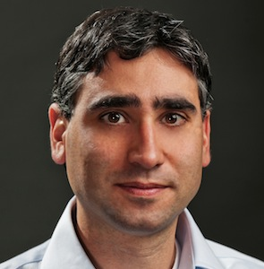
Research community in 2006
Stanford Clean Slate Program “What would we do if we started (the Internet) again?”
2. Martin Casado and the Ethane Project

Slide 19
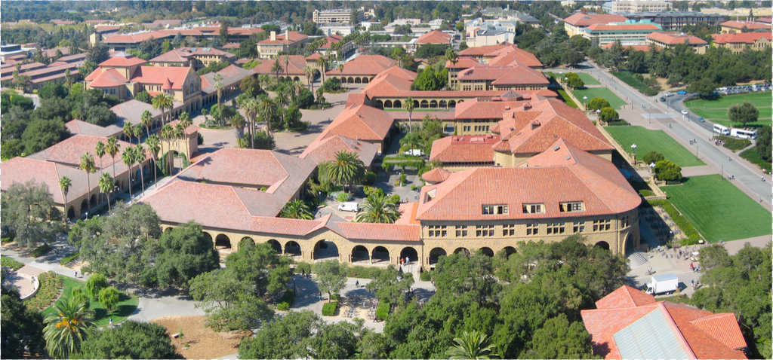
How difficult is it to define all network operations in software, outside the datapath?
Stanford campus
35,000 users
10,000 new flows/sec
137 network policies
2,000 switches
2,000 switch CPUs
2006

Slide 20



Crazy question: What if software decides whether to accept each flow, and how to route it?
Controllers
Check flow against policy
Pick route
B
A
[Sigcomm ’07, Kyoto]

Slide 21
How many $400 servers do we need for 35,000 Stanford users?
Answer: Less than one!

Slide 22

If we can define network behavior outside the datapath, then eventually we will.

Slide 23
Software Defined Network (SDN)
Control
Program
Control
Program
Control
Program
Global Network Map
Control Plane
OpenFlow
Control
Packet
Forwarding
Control
Packet
Forwarding
Control
Control
Packet
Forwarding
Packet
Forwarding
Control
Packet
Forwarding

Slide 24
Dijkstra
IS-IS
BGP
MPLS
Firewall…
Global Network Map
Network OS
Forwarding
Forwarding
Forwarding
Forwarding
Notes:
Design distributed system once, then reuse for many control programs.
Disentangles the two. Simplifies the control programs.
In classes, now have students create new control programs to change the behavior of the network in a few days. Before it took a team of 5-10 engineers several months.

Slide 25
Quickly led to…
OpenFlow, SDN, Open vSwitch, network virtualization, …
In 2005, every data center and ISP was built using closed, proprietary routers.
Today, the top 10 data center owners all build their own, and write their own software (or use open source)

Slide 26
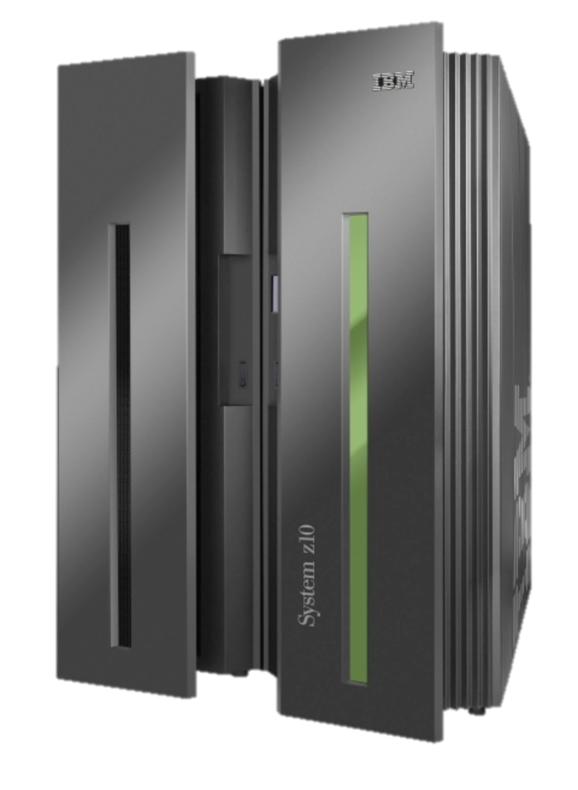
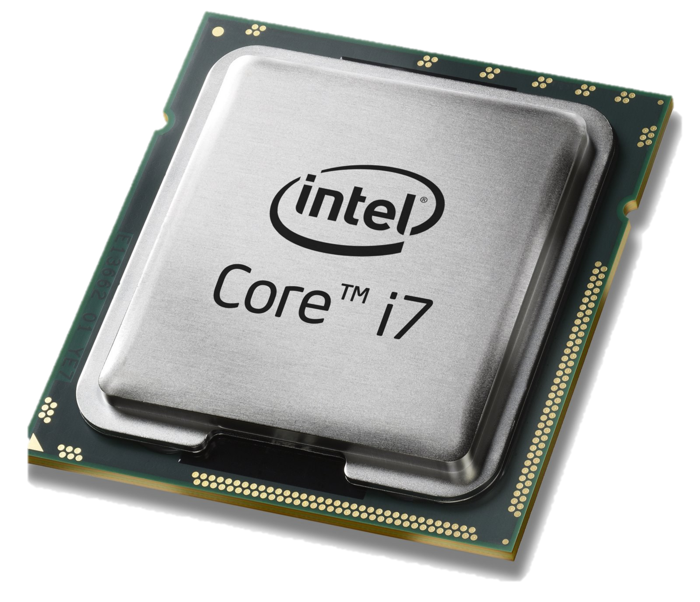
Computer Industry
App
App
App
App
App
App
App
App
App
App
App
Specialized
Applications
Open Interface
Specialized
Operating System
Windows
(OS)
Linux
Mac
OS
or
or
Open Interface
Specialized
Hardware
Microprocessor

Slide 27
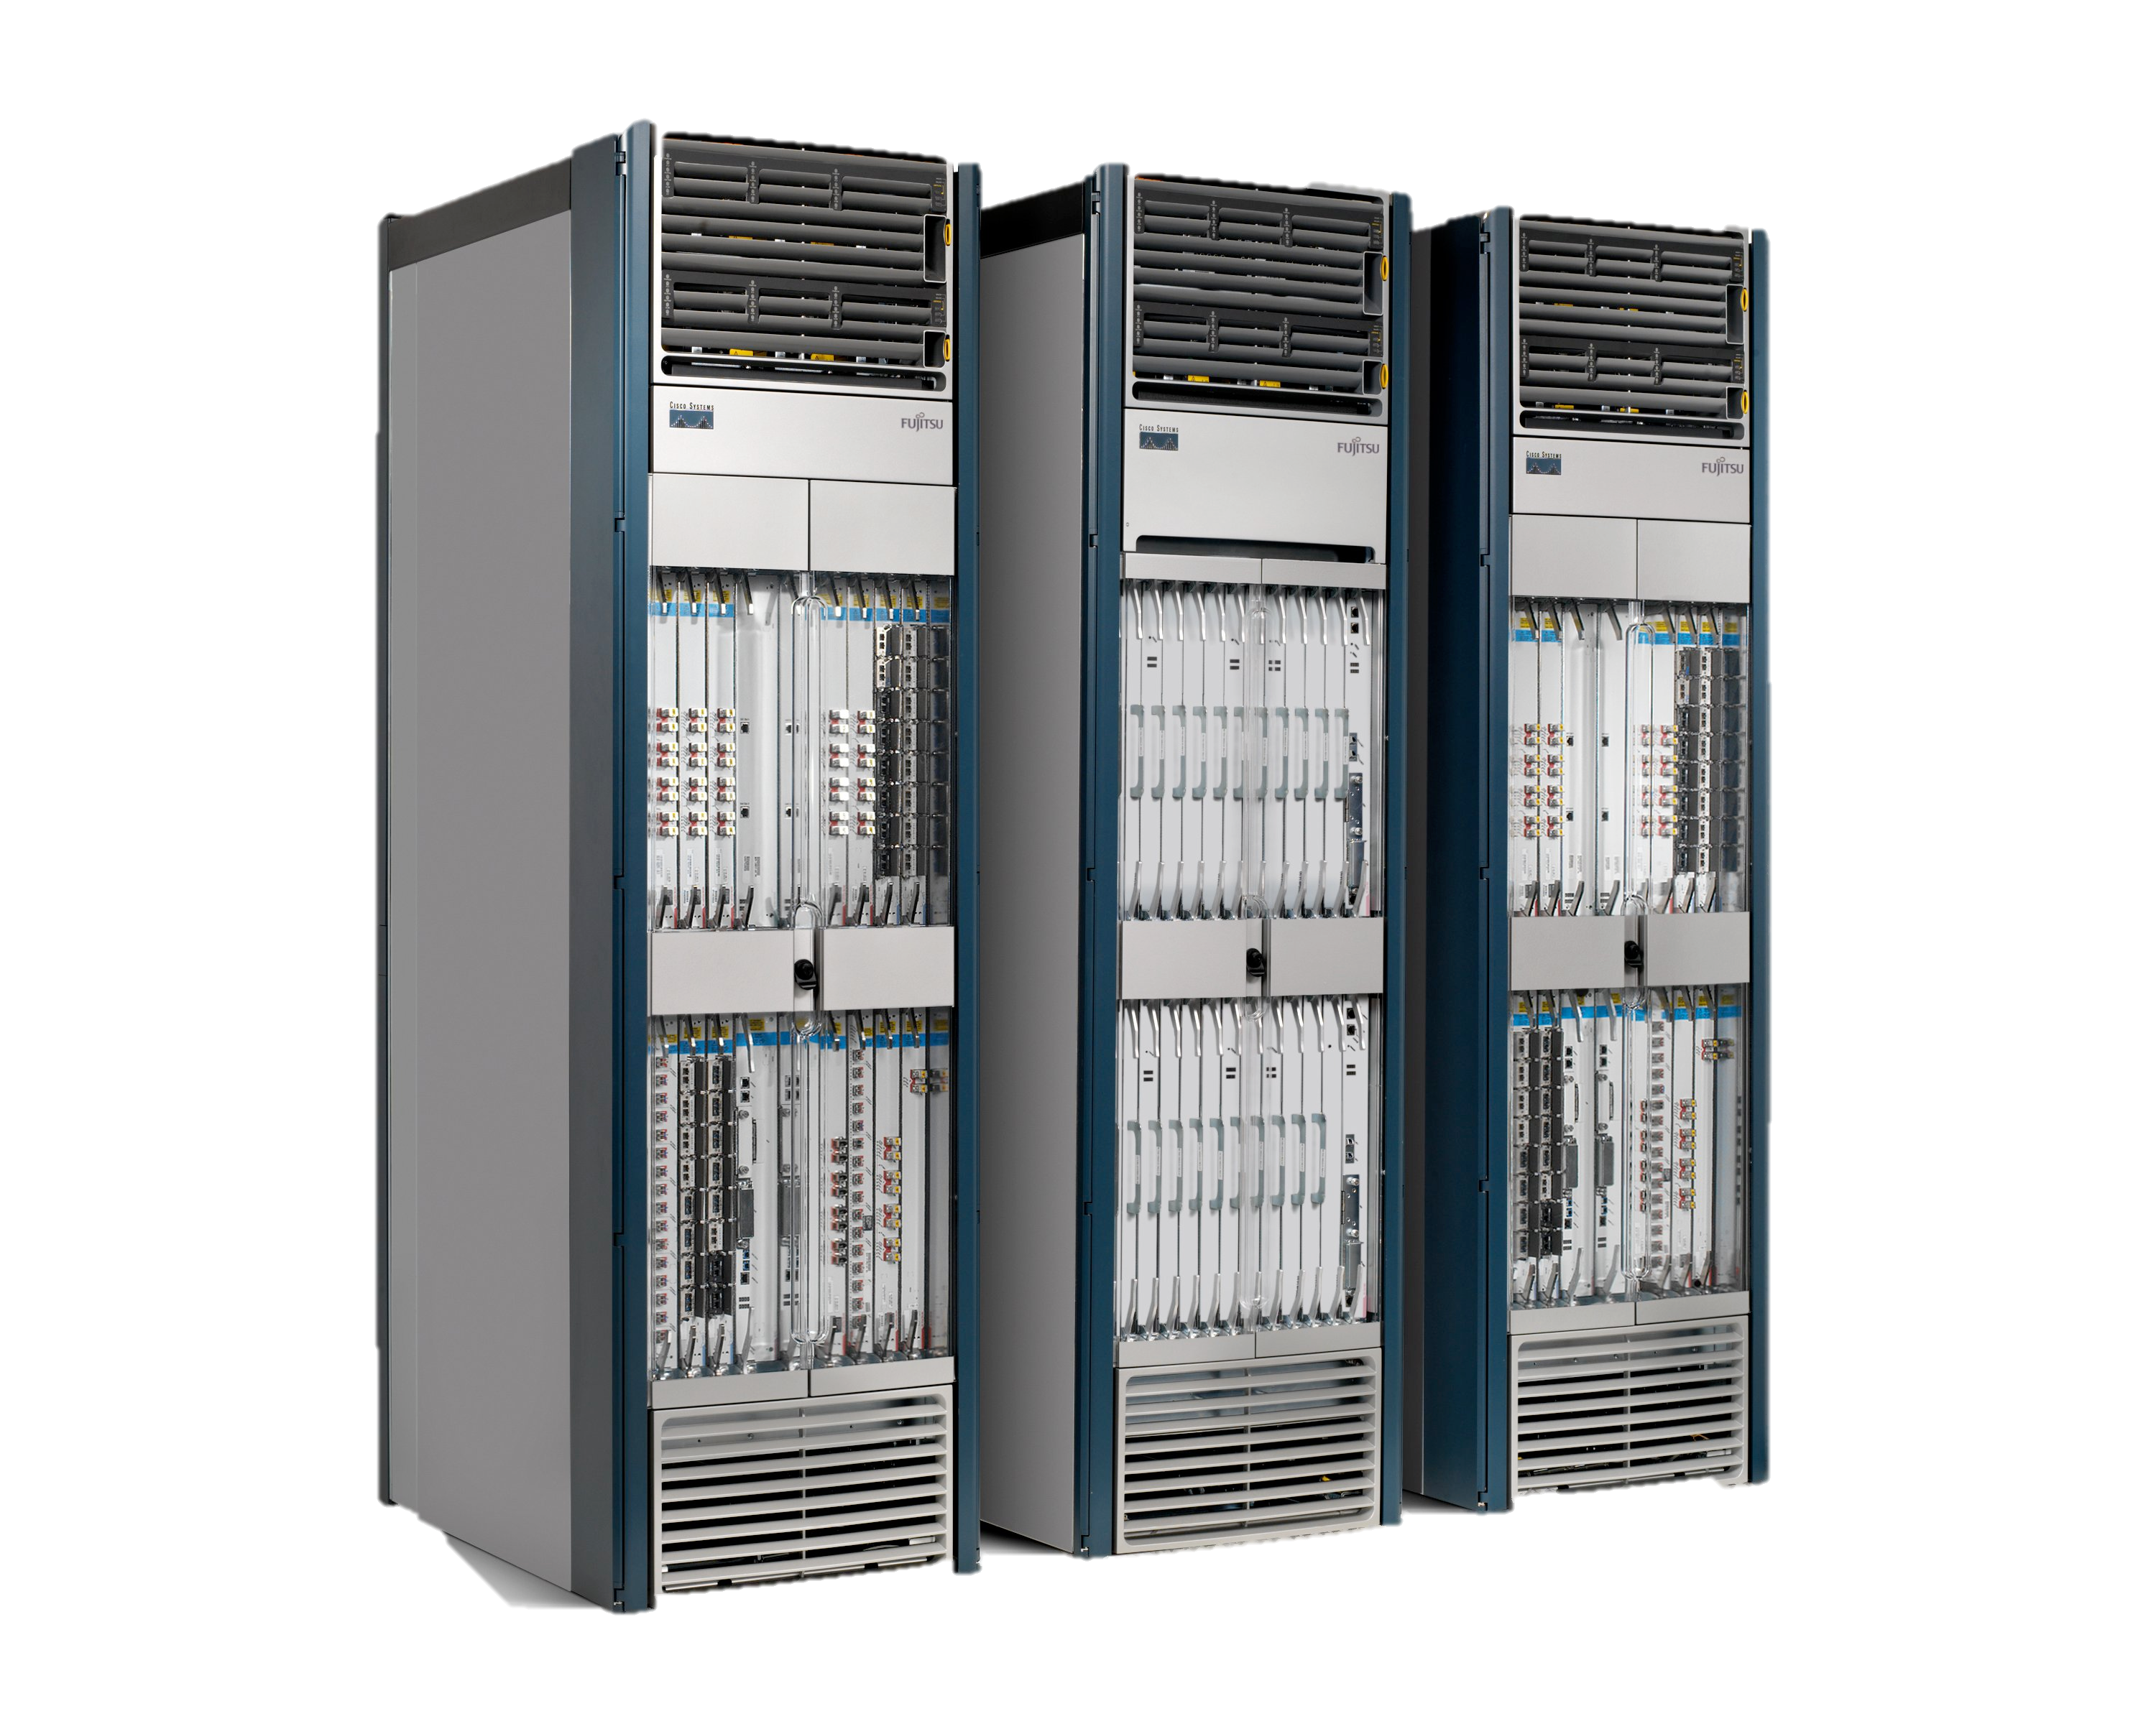
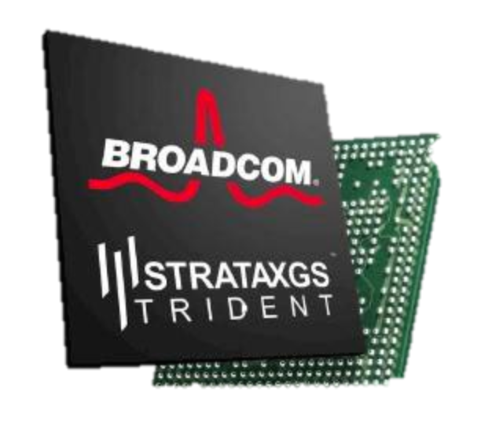
Networking Industry
App
App
App
App
App
App
App
App
App
App
App
Specialized
Features
Open Interface
NOX
Beacon
ONIX
POX
ONOS
Flood light
Trema
ODL
Ryu
Control Plane 1
Control Plane 2
Specialized
Operating System
Open Interface
Switch Chips
Specialized
Hardware

Slide 28
Network Function Virtualization (NFV)
Public Internet
Middlebox
Firewalls
Load-balancing
NAT
Boundary routers
Deep Packet Inspection
DDoS Mitigation
Middlebox
Middlebox
Middlebox
Packet
Forwarding
Packet
Forwarding
Packet
Forwarding
Packet
Forwarding
Packet
Forwarding

Slide 29
Network Function Virtualization (NFV)
Public Internet
VM
VM
VM
Middlebox
Packet
Forwarding
VM
VM
VM
Firewalls
Load-balancing
NAT
Boundary routers
Deep Packet Inspection
DDoS Mitigation
Packet
Forwarding
Packet
Forwarding
Packet
Forwarding
Packet
Forwarding
Packet
Forwarding

Slide 30
With hindsight, Disaggregation, SDN and NFV were inevitable
Part of a bigger trend towards the owners and operators of networks taking control of how they work

Slide 31
Inevitable because…
Rise of Linux.
Rise of baremetal servers and data centers.
SDN: Rise of merchant switching silicon.
NFV: Rise of computer virtualization.

Slide 32
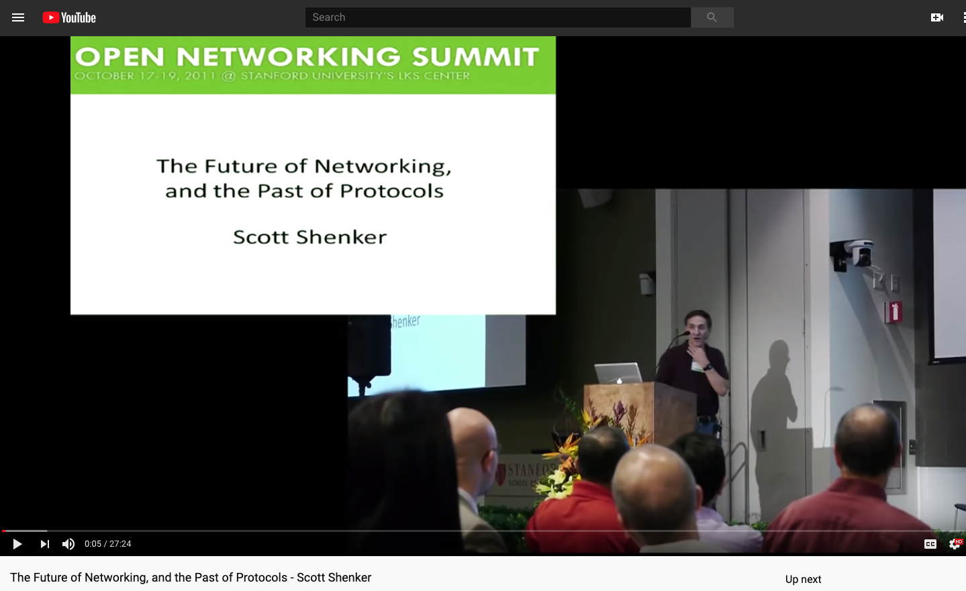
“The Future of Networking and the Past of Protocols” Scott Shenker 2011
link
Notes:
The best intro to what SDN is about from a technical viewpoint…

Slide 33
Coming up later this week….
Wednesday: Jeff Mogul (Google) He will build on some of the things you will learn today.
Friday: (Nick) Network Virtualization.

